Slide 1
“Teach A Level Maths”
Statistics 1
Tree Diagrams
© Christine Crisp

Slide 2
Statistics 1
AQA
EDEXCEL
MEI/OCR
OCR
"Certain images and/or photos on this presentation are the copyrighted property of JupiterImages and are being used with permission under license. These images and/or photos may not be copied or downloaded without permission from JupiterImages"

Slide 3
This presentation reminds you about the tree diagrams you used in GCSE.
We will use tree diagrams with some extra notation in the next presentation to solve some conditional probability problems.

Slide 4
We use the word event in statistics to refer to a possible result from a trial or experiment.
e.gs. A seed growing into a red flower.
A six showing when we throw a die.
A tree diagram shows the probabilities of 2 or more events.
e.g. There are 5 chocolates left in a box all looking the same. 3 are raspberry creams (R), 2 are nougats (N)
(a) Draw a tree diagram to show the probabilities if
2 chocolates are taken at random.
(b) Find the probabilities of
(i) both being nougats
(ii) the 1st being a raspberry cream and the
2nd being a nougat
(iii) one of each type

Slide 5


5 chocolates: 3Rs, 2Ns
Solution:
1st chocolate
2nd chocolate
R
R
Tip: To get to this branch, we’ve come up here . . .
3 of the 5 chocolates are Rs
The 1st chocolate can be R or N so we need 2 branches
N
2 of the 5 chocolates are Ns

Slide 6
5 chocolates: 3Rs, 2Ns
Solution:
1st chocolate
2nd chocolate
R
R
Tip: To get to this branch, we’ve come up here . . .
So an R has gone.
N

Slide 7

5 chocolates: 3Rs, 2Ns
Solution:
1st chocolate
2nd chocolate
R
R
N
N

Slide 8
5 chocolates: 3Rs, 2Ns
Solution:
1st chocolate
2nd chocolate
R
R
N
Both the Ns are left
N

Slide 9

5 chocolates: 3Rs, 2Ns
Solution:
1st chocolate
2nd chocolate
R
R
N
R
N
To reach here, an N has gone so all 3 Rs are left.

Slide 10

5 chocolates: 3Rs, 2Ns
Solution:
1st chocolate
2nd chocolate
R
R
N
R
N
N
and only 1 N is left

Slide 11
5 chocolates: 3Rs, 2Ns
Solution:
1st chocolate
2nd chocolate
R
R
We need to multiply to find the probability of reaching the end of each branch.
N
R
N
N

Slide 12
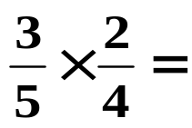

5 chocolates: 3Rs, 2Ns
Solution:
1st chocolate
2nd chocolate
R
R
N
R
N
N

Slide 13
5 chocolates: 3Rs, 2Ns
Solution:
1st chocolate
2nd chocolate
R
R
N
R
N
N

Slide 14
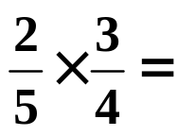
5 chocolates: 3Rs, 2Ns
Solution:
1st chocolate
2nd chocolate
R
R
N
R
N
N

Slide 15
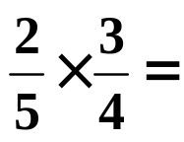
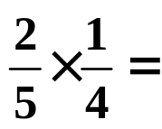

5 chocolates: 3Rs, 2Ns
Solution:
1st chocolate
2nd chocolate
R
R
N
R
N
N

Slide 16


5 chocolates: 3Rs, 2Ns
Solution:
1st chocolate
2nd chocolate
R
R
N
R
N
N
Tip: The four probabilities added together equal 1

Slide 17
5 chocolates: 3Rs, 2Ns
Solution:
1st chocolate
2nd chocolate
R
R
N
R
N
N

Slide 18
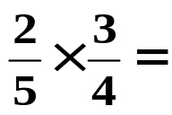
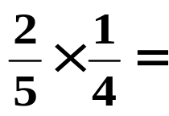

(b) Find the probabilities of (i) both being Ns (ii) the 1st being R and the 2nd N:
1st chocolate
2nd chocolate
R
R
N
R
N
N
Solution:
(i)

Slide 19


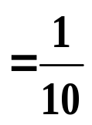


(b) Find the probabilities of (i) both being Ns (ii) the 1st being R and the 2nd N:
1st chocolate
2nd chocolate
R
R
N
R
N
N
Solution:
(i)
(ii)

Slide 20


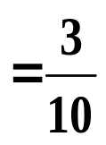
(b) Find the probabilities of (i) both being Ns (ii) the 1st being R and the 2nd N (iii) one of each type
1st chocolate
2nd chocolate
R
R
N
R
N
N
Solution:
(i)
(ii)

Slide 21

(b) (iii) probability of one of each type
Solution: There are 2 ways to get one of each type:
1st chocolate
2nd chocolate
R
R
N
R
N
N

Slide 22
(b) (iii) probability of one of each type
Solution: There are 2 ways to get one of each type:
1st chocolate
2nd chocolate
R
R
N
R
N
N

Slide 23
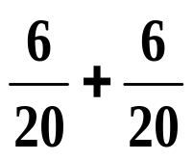
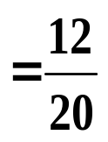




(b) (iii) probability of one of each type
Solution: There are 2 ways to get one of each type:
1st chocolate
2nd chocolate
R
R
N
+
R
N
We need to add to find the probability of moving along one branch or another.
N
or

Slide 24



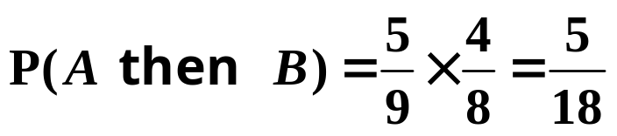
SUMMARY
A tree diagram shows the probabilities of more than one event.
To find probabilities for a branch always assume the event on the branch leading to it has occurred.
e.g.
A
B
Assumes A has occurred
To find the probability of 2 events, multiply the individual probabilities.
e.g.
A
B
continued

Slide 25

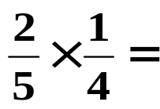


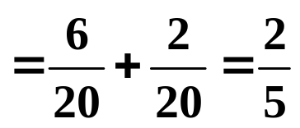
SUMMARY
To find the probability of 1 event or another, add the individual probabilities.
e.g.
A
C
B
D
P(A and C or B and D)

Slide 26

Exercise
1. There are 4 red and 6 blue biros in a drawer. Two are taken out at random. Draw a tree diagram showing the probabilities of the different events if
(a) The 1st is replaced before the 2nd is taken, and
(b) The 1st is not replaced before the 2nd is taken.
In each case find the probability of one red and one blue.
2. Components for a machine are supplied by 3 factories A, B and C. 45% come from A, 25% from B and the rest from C. Data shows that 4% of those from A, 5% of those from B and 2% of those from C are faulty.
Draw a tree diagram showing all the probabilities and use it to find the probability that a randomly selected component is faulty.

Slide 27

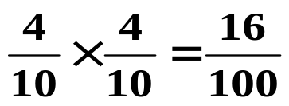
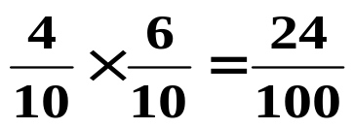


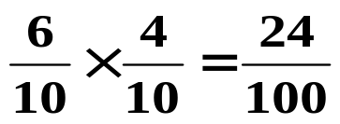
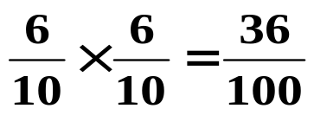
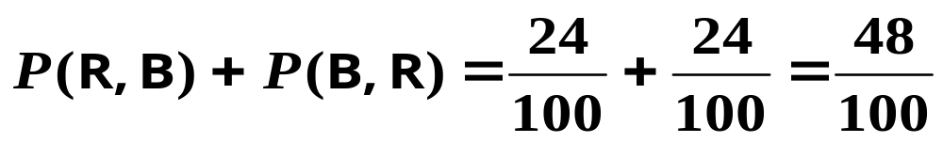

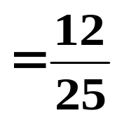

1. There are 4 red and 6 blue pens in a drawer. Two are taken out at random. Draw a tree diagram showing the probabilities of the different events if
(a) The 1st is replaced before the 2nd is taken.
1st
2nd
R
R
B
R
B
B
P ( one red and one blue ) =

Slide 28

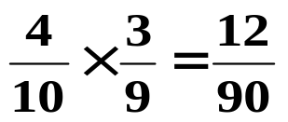
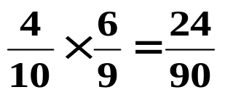


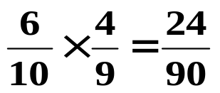

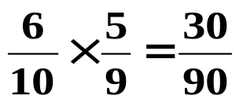
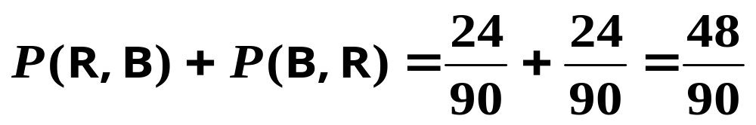

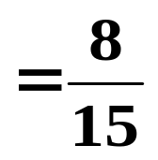

1. There are 4 red and 6 blue pens in a drawer. Two are taken out at random. Draw a tree diagram showing the probabilities of the different events if
(b) The 1st is not replaced before the 2nd is taken.
1st
2nd
R
R
B
R
B
B
P ( one red and one blue ) =

Slide 29















2. Components for a machine are supplied by 3 factories A, B and C. 45% come from A, 25% from B and the rest from C. Data shows that 4% of those from A, 5% of those from B and 2% of those from C are faulty.
F
A
N
F
B
N
F
C
N

Slide 30

F
A
N
F
B
N
F
C
N

Slide 31
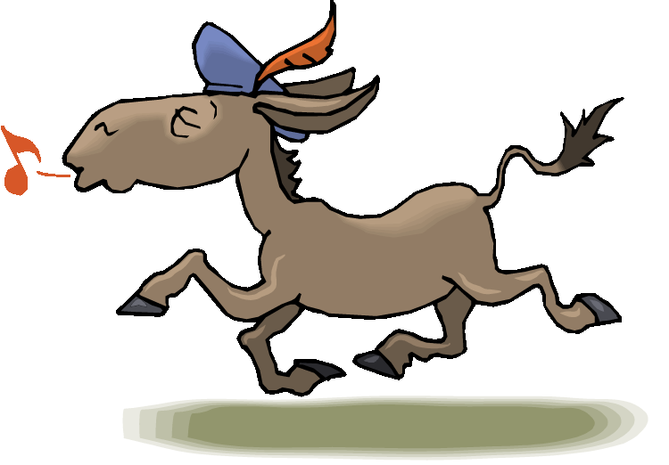

Slide 32
The following slides contains the summary, shown without colour, so that they can be printed and photocopied.

Slide 33
SUMMARY
A tree diagram shows the probabilities of more than one event.
To find probabilities for a branch always assume the event on the branch leading to it has occurred.
e.g.
A
B
Assumes A has occurred
To find the probability of 2 events, multiply the individual probabilities.
e.g.
A
B
continued

Slide 34
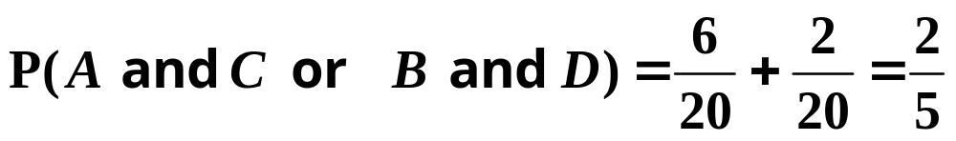
SUMMARY
To find the probability of 1 event or another, add the individual probabilities.
e.g.
A
C
B
D

